Slide 1

SAHYOG
(a helping hand)
Praveen Kumar S1
(03111604420)

Slide 2
DESCRIPTION
“SAHYOG” is a web application which aims to connect the needy ones to those who are willing to help someone without any demand. The focus of “SAHYOG” is to match users based on locations where they live or want.

Slide 3
This website has two types of users one who wants to help someone and the other who has some needs which he/she wants to learn in free . Both have to make an account on the portal and then this website matches them accordingly based on their location and service type. If the services a person wants to take and another person who wants to help someone both have the same location and same service they both will find each other and can directly share their contact number.

Slide 4
Technology Used
React JS
Express framework
Mongo DB
Mongoose
Code SandBox
Atlas
CSS

Slide 5
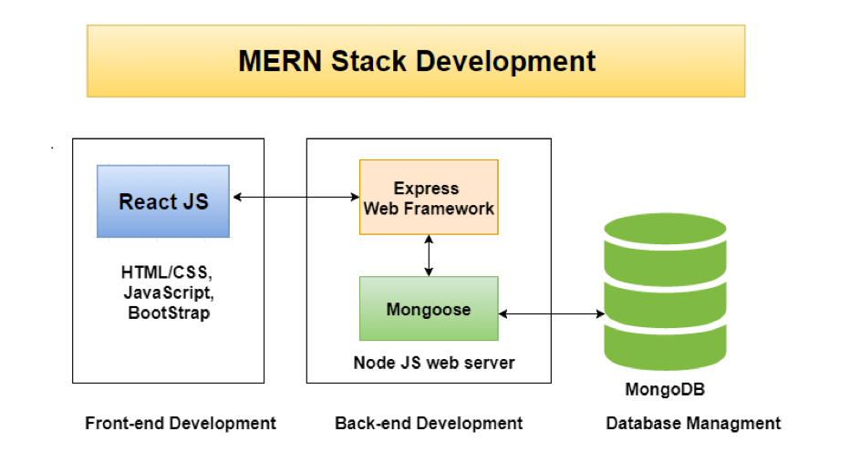

Slide 6
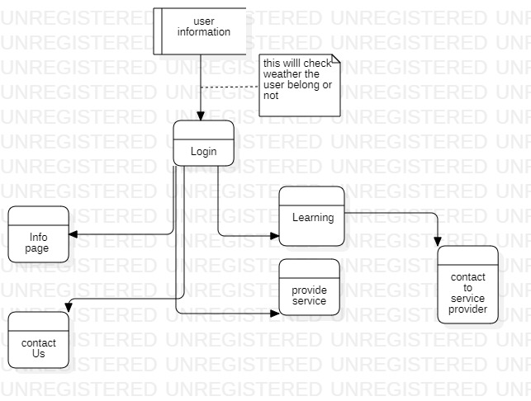
DFD Diagram

Slide 7
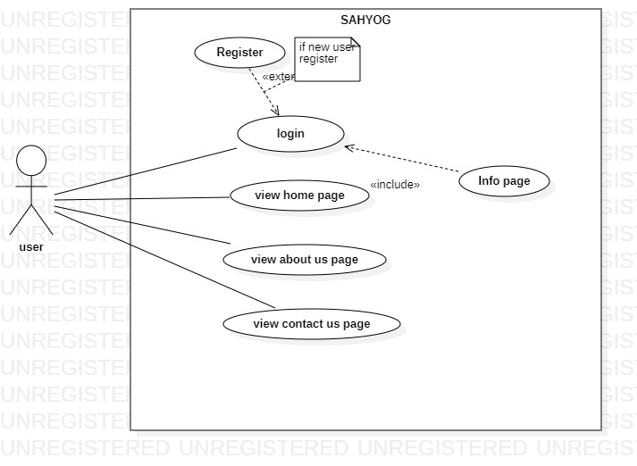
Use Case Diagram

Slide 8
# Milestone hit till now
1. Designed a signature logo for our web application(SAHYOG)

Slide 9
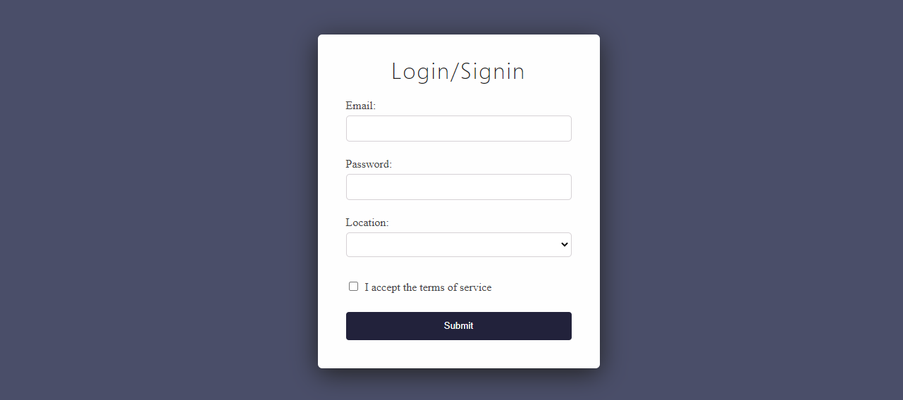
2. Designed and code a Login/Signin form using REACT

Slide 10
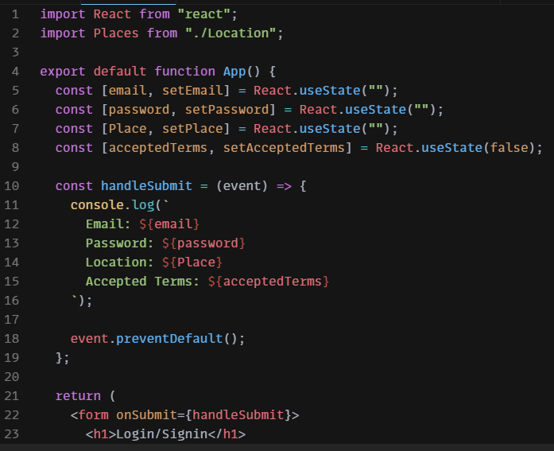
CODING :

Slide 11
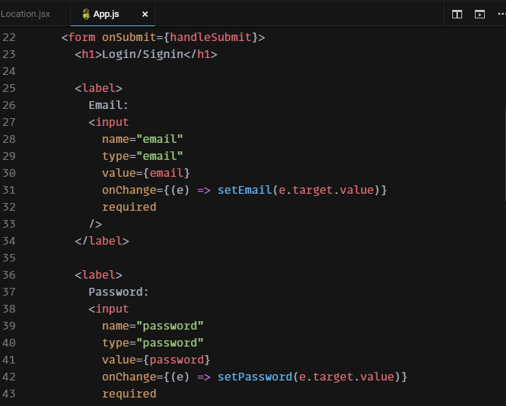

Slide 12
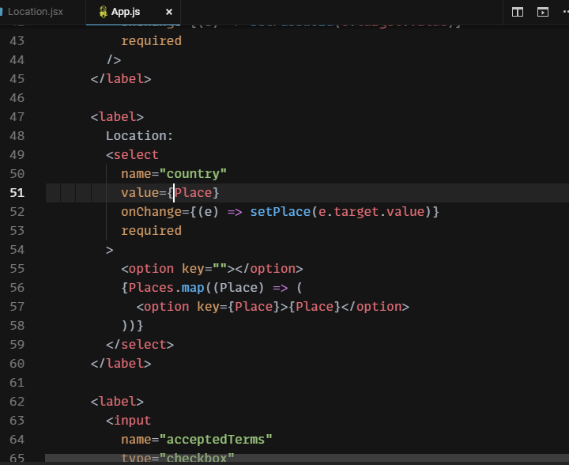

Slide 13
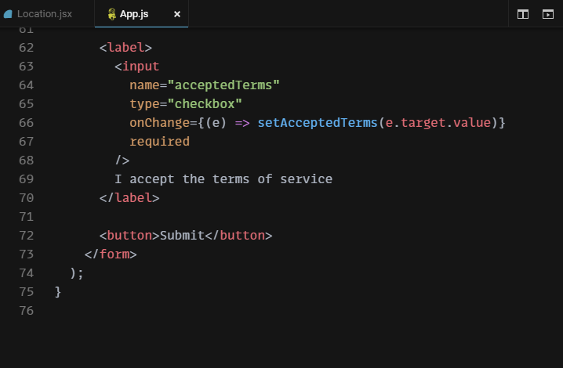

Slide 14
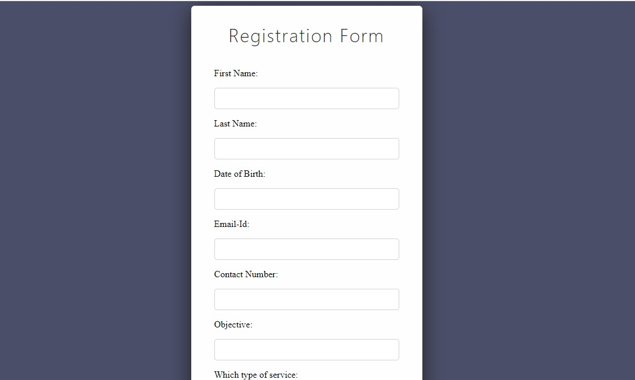
3. Designed and code a Registraton form using REACT

Slide 15
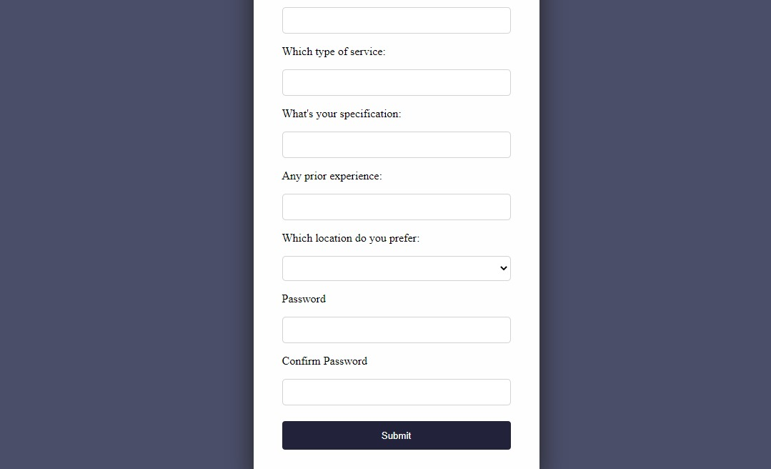

Slide 16
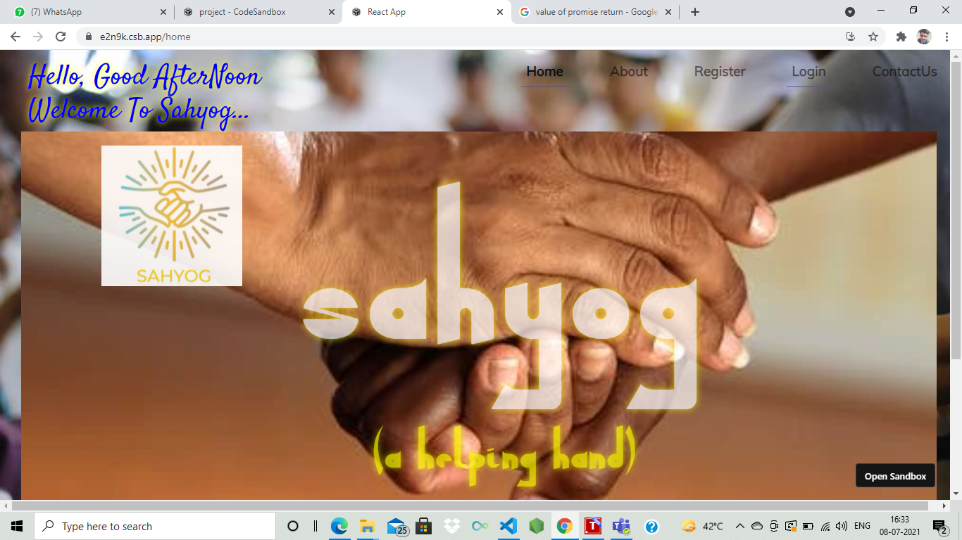
Home Page

Slide 17
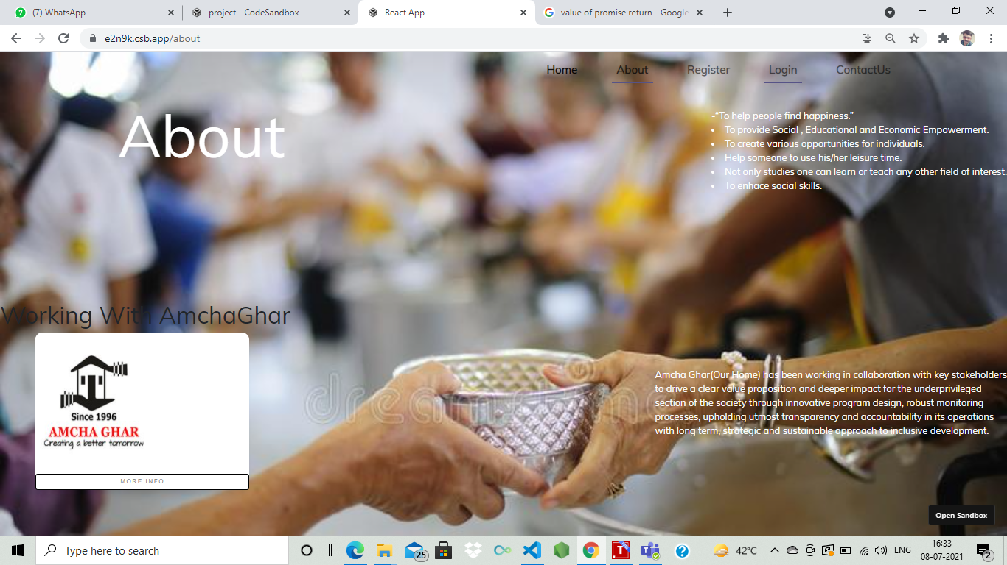
About Page

Slide 18
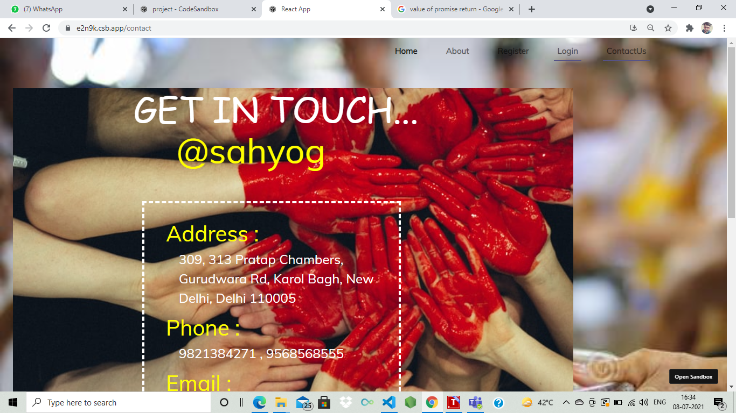
Contact Us Page

Slide 19
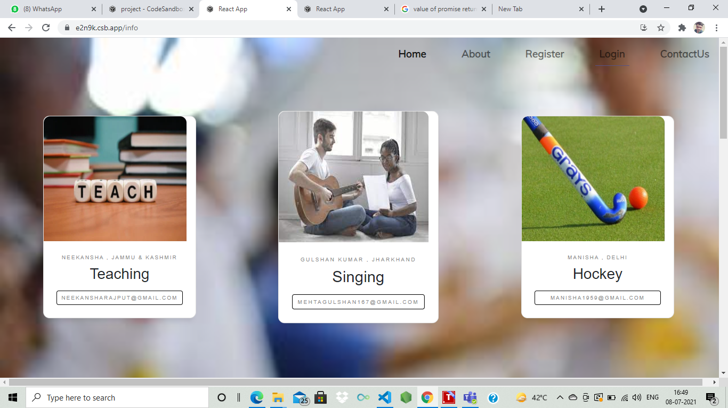
Info Page(SECRET PAGE)

Slide 20
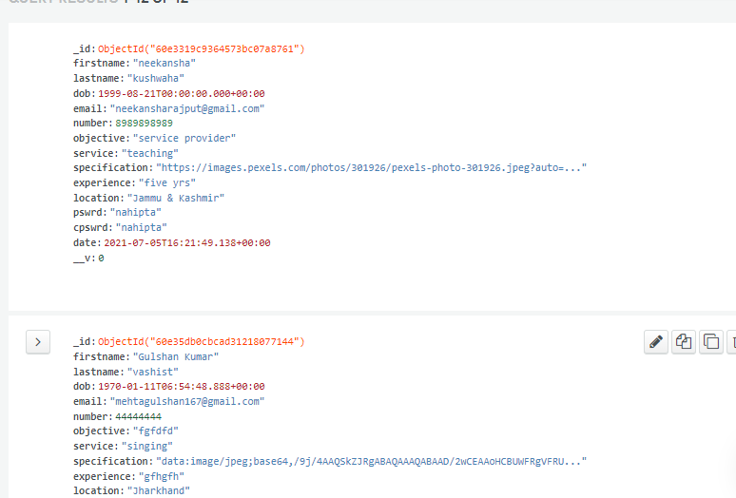
MONGO DB

Slide 21
Bibliography
The refrences for the above project are as :
WebSite :- reactjs.org
YouTube :- Thapa Technical
W3 School for CSS
StackOverflow for queries

Slide 22
!!!! THANK YOU !!!!

